Slide 1
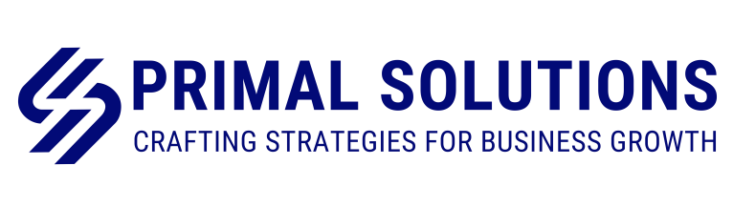
Website Additional Content Inputs
Primal Solutions

Slide 2


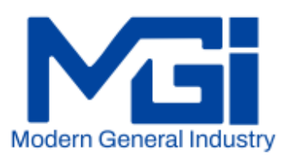
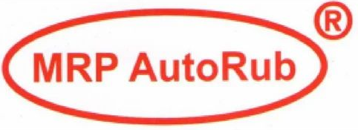

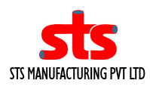

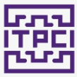

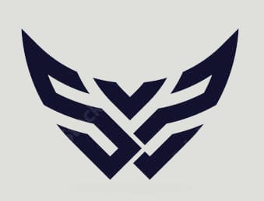

Slide 3
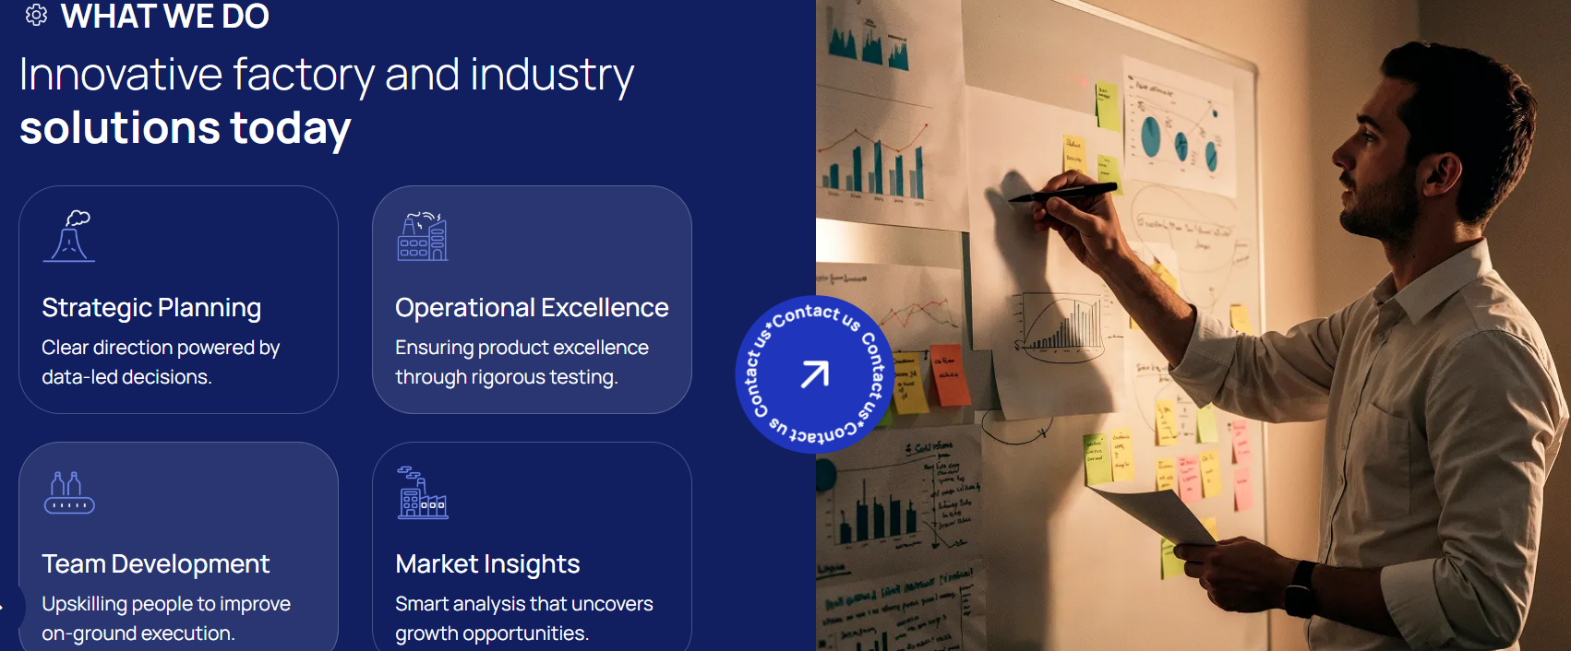
About Us
Strategic Planning
Turning vision into action through clear strategy, performance-driven KPIs, and scalable growth.
Operational Excellence & Lean Transformation
Driving operational excellence by eliminating waste and embedding Lean practices for sustained performance.
Digital & Smart Factory Transformation
Transforming traditional plants into smart, data-driven factories through digital integration and advanced analytics
Talent Acquisition & Skill Development
Building strong organizations through the right hiring and future-ready skill development
Note :
Please replace the heading and content as shown

Slide 4
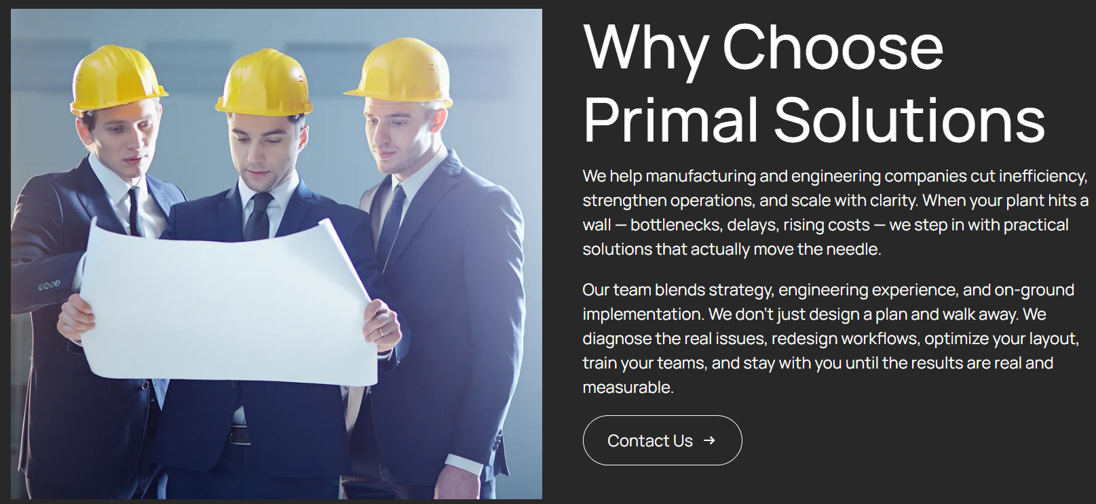
Sector Page
We turn strategic vision into measurable results through hands-on, execution-focused consulting. Combining deep industry expertise with performance-driven frameworks, we help organizations optimize operations, enter markets successfully, and build lasting competitive advantage—aligning strategy, operations, and capability development for sustainable growth.
Note :
Please replace the content and change the picture

Slide 5
FAQ’s
What consulting services do you offer?
We offer end-to-end consulting in strategy, operations, digital transformation, market insights, talent, and skill development.
2. How can Primal Solutions help my business grow?
We turn your vision into action, optimize operations, enable market success, and build capabilities for sustainable growth.
3. Which industries do you serve?
We deliver tailored best-practice solutions across manufacturing, technology, services, and high-growth sectors
4. How do I start a consulting engagement?
We understand your needs and deliver a tailored proposal with scope, timeline, and measurable results.”
5. How do you measure the success of your projects?
KPIs and measurable outcomes demonstrate the success of our projects

Slide 6

Consultant Profile

Slide 7
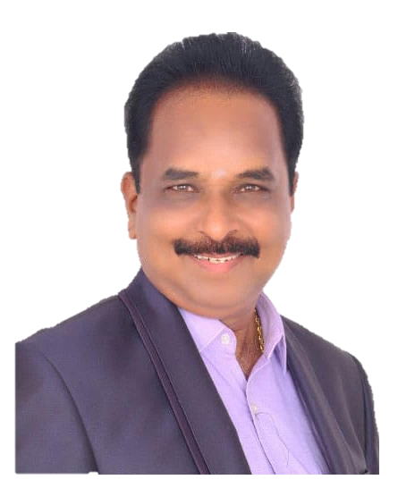
T.R Renukanthan
Business Excellence – Consultant
Primal Solutions
DGM Central Quality (Rtd.), Ashok Leyland
+91 98415 68728
  Professional Experience
Engage with top management of manufacturing organizations on goal setting, KPIs, Strategic plan creation, systems improvement, etc.
Rich experience in TQM particularly Policy and Daily Management
Extensive experience in providing training to individuals on the shop floor, focusing on good manufacturing practices, team building, and leadership skills.
AIAG Core Tools (PPAP, APQP, Problem solving tools and OEMs assessment audit)
35+ years of experience in working with SRP Tools, a Non-Standard Cutting Tool Manufacturer, SFL Autolec, Water, Oil & Fuel Pump Manufacturer, and 19-year long tenure at Ashok Leyland.
Expertise in Manufacturing, Assembly, Painting Process, Supplier Quality Function Strategy and formulation, and the utilization of Digital Quality, specifically PPAP Collaborative Space in PLM Platform
  Competencies
  Painting Process
  Lean Six Sigma
  AIAG Core Tools
  Manufacturing and Assembly
  Quality Management Systems
  Coach & mentor trainees
  Education Background
  Diploma in Mechanical Engineering - Central Polytechnic
  BE Manufacturing - College of Engineering - Guindy
  Expertise
  Trained for Cellular Manufacturing system by CSC – Manufacturing
  Certified Lead Auditor in QMS & Lean Six Sigma Green Belt

Slide 8
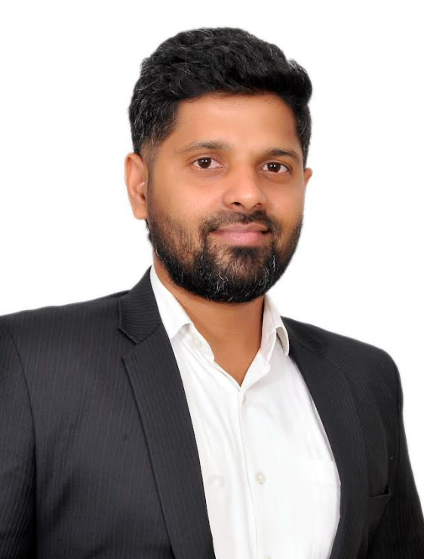
Ashok Soundararajan
  Professional Experience
  Implement turnkey projects at manufacturing MSMEs on quality, continuous Improvement & profitability turnaround.
Engage with top management of manufacturing organizations on goal setting, Business plan, Strategic plan & KPIs creation, systems improvement, etc.
Implemented Lean manufacturing practices in over 75 MSME units across commodities and industries.
Worked with MSME-Lean Cluster through LMCS
Helped Tier-1 manufacturing companies to set up a greenfield production and assembly line for their Japanese OEM clients.
Trained over 500+ Engineers in AIAG Core Tools (PPAP, APQP, Problem solving tools and OEMs assessment audit)
Business Consultant
Primal Solutions
+91 90030 71320
Over a decade of experience in Quality Engineering, Quality system management, Problem solving technique, Product development, Operational improvement, Continual improvement, Supplier audit system.
Comprehension of the needs of prominent OEMs such as Ashok Leyland, TAFE, PSA, and other automotive suppliers to enhance their suppliers' capacities, quality assurance processes, NPD methodologies, and overall quality strategy
Extensive experience in sheet metal and fabrication, specializing in press shop operations and welding. Proficient in tool design, Poka yoke implementation, tool management, and resolving quality issues.
  Competencies
  Lean Six Sigma
  AIAG Core Tools
  Quality Management Systems
  Coach & mentor trainees
  Expertise
  SCM-Exe from CII (Confederation of Indian Industry).
  Certified ISO 9001:2015 Lead Auditor Course (TUV SUD)
  Total Quality Management at MSME Development Institute, Chennai.
  Contemporary Shop Floor Management at NIQR, Mahindra Institute of Quality.
  Operational Excellence Course for COO & Young Leaders at NIQR.
  Education Background
  Bachelor of Engineering (2005-2009)

Slide 9
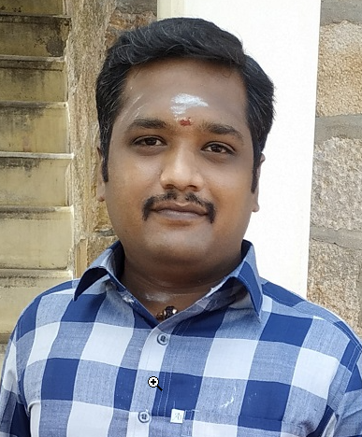
Ramkumar S
Role : Senior Consultant
Nationality: Indian
Languages: English, Tamil
  Professional Experience
Extensive experience in providing training to individuals on the shop floor, focusing on good manufacturing practices, team building, and leadership skills.
Implemented Lean manufacturing practices in sheet metal commodities and industries.
Vendor development and monitor the supply chain strategy, to improve the productivity and efficiency, reduce costs while securing high quality material for their company.
Trained over 100+ Engineers in AIAG Core Tools (Study of drawings, GD&T, Core tools and Problem solving)
Over a decade of experience in Quality Engineering, Problem solving technique, Continual improvement, Supply chain management.
Comprehension of the needs of prominent OEMs such as Commercial, Passenger car segment and other automotive suppliers to enhance their supplier’s capabilities, strengthening process control, quality assurance processes and overall quality strategy
Extensive experience in sheet metal and fabrication, casting and machining, specializing in press shop operations and welding process. Proficient in tool design, Poka yoke implementation and resolving quality issues.
  Competencies
  Lean Six Sigma
  AIAG Core Tools
  Quality Management Systems
  Coach & mentor trainees
  Expertise
  Certified ISO 9001:2015 Lead Auditor Course (TUV SUD)
  Sig Sigma Green Belt
  Education Background
  Bachelor of Mechanical Engineering

